Slide 1
Kaiba Corp. EE Capstone 2014
Alyanna Castillo
Patrick Ma
Ryan McDaniel

Slide 2
Presentation Flyover
Vision & project Summary
Deliverables
Define requirements and specifications
High level implementation details
Describe HW/SW
System flow
General game play
Issues encountered
Latest Results
Current project status
Comments

Slide 3
Project vision
Problems:
Design a complete embedded capstone
Must have at least 60% hardware components
Children looking for entertainment
Teach children
Our solution:
Build an RFID compatible learning device
Plays educational and entertainment games

Slide 4
Capstone Deliverables
One working prototype system
Documentation
Another working prototype system (hopefully)

Slide 5
System Requirements

Slide 6
Specifications

Slide 7
Our idea
Put the hw block diagram here
Front end + back end idea

Slide 8
Hardware summary
Components used

Slide 9
Schematic

Slide 10
Software functions

Slide 11
State machines
Basic system flow
Generic game flow

Slide 12
Issues Encountered
Lack of memory + pins
Solution: switched to larger chip from same family
PIC18F46K22
36 GPIO pins
Solution: use a two-level system (frontend + backend)
UART ISR overflow
Occurred when reading RFID tags
Limited to specific functions
Root cause:
excessive context switch lag time
Solution:
remove function calls within ISR
Instruct Compiler to not save data

Slide 13
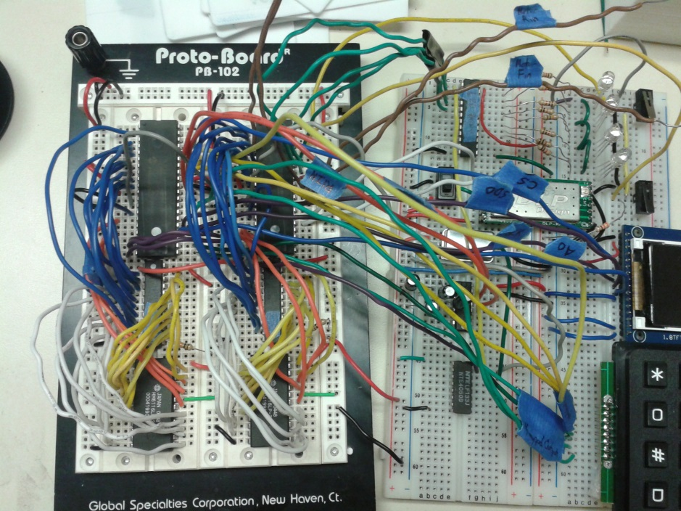
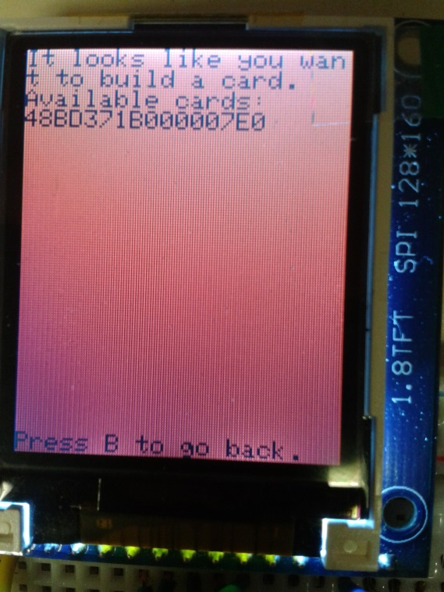
Status
Most hardware modules tested/working
Integrating software drivers with scheduler
Current game idea?

Slide 14
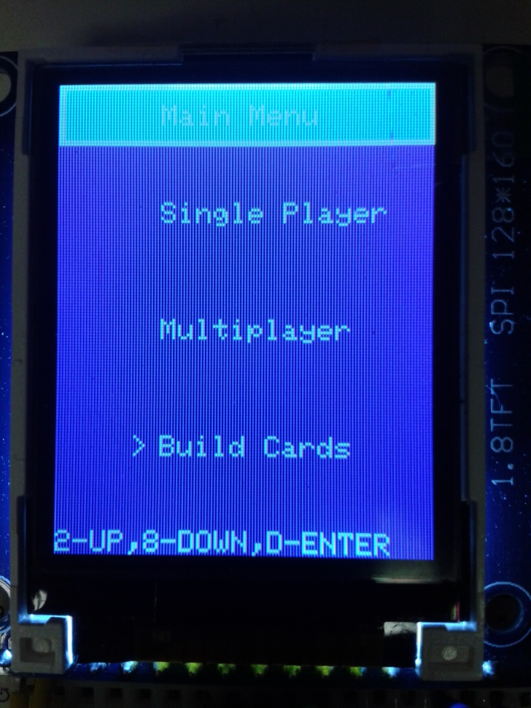
Future work
Implement UX reaction
Integrate to scheduler
XBee / intersystem comm
Game loading software

